Slide 1
RANDOM FOREST
Gowtham K Jayachandiran

Slide 2
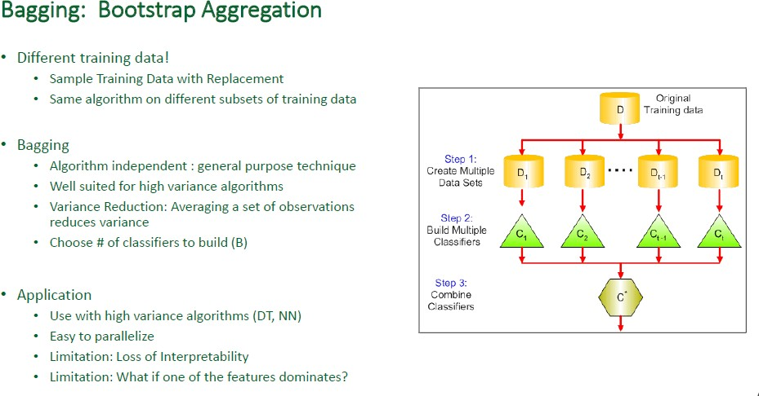

Slide 3
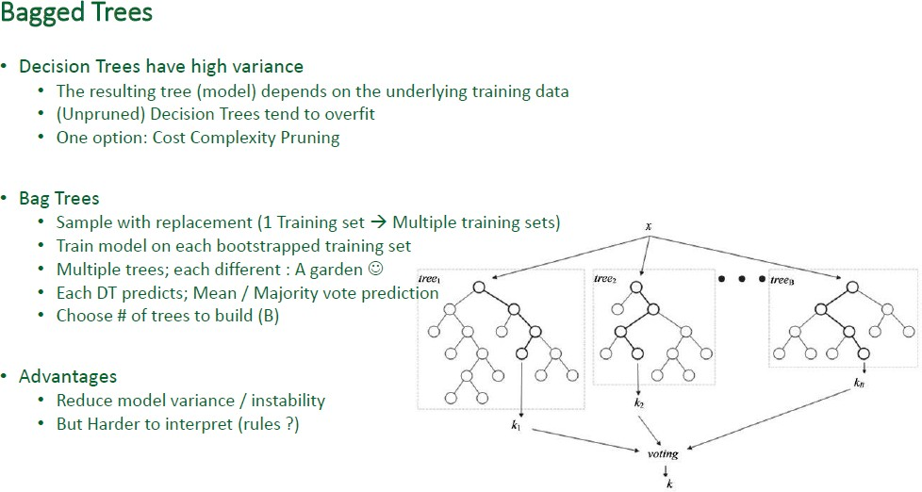

Slide 4
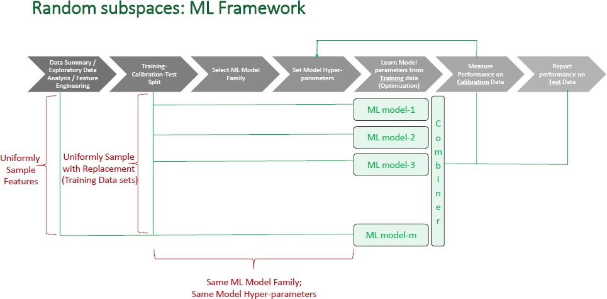

Slide 5
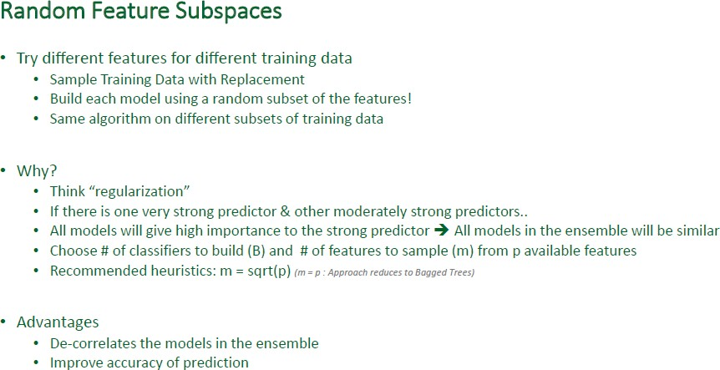

Slide 6
